Slide 1
Principles of Insurance

Slide 2

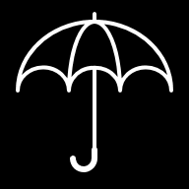



What will we learn in this module?
Fundamental Principles of Insurance

Slide 3
What will we learn in this module?
Concept of Insurance and Insurance Contracts
Concept of Risk and various Risk Management Techniques
Law of Large Numbers
Fundamental Principles of Insurance

Slide 4
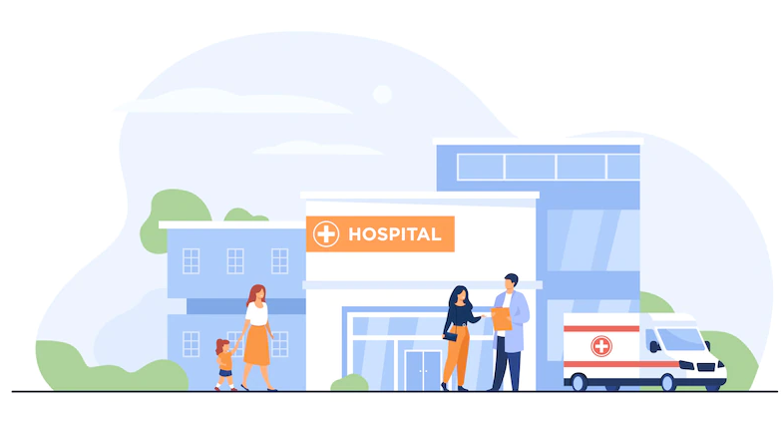
Recap: What is risk?
Risk is defined as the possibility or chance of loss due to occurrence of an event.
For example, while driving to work each day, you may have an automobile accident. Or you might accidentally slip, fall, and injure yourself while running on your treadmill.
It is uncertain if either of these accidents will occur—but the possibility (risk) does exist.

Slide 5
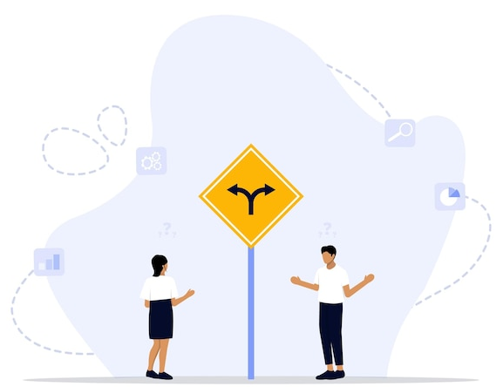
Recap: What are the different types of Risk ?
Pure Risk
Speculative Risk
Situation where there are possibilities of only loss or no loss
There is no possibility of any gain or profit in Pure risks.
For Example,
Joe has a hot year playing cards and decides to buy a new house. Joe reaches out to an Insurance agent to buy a homeowner’s policy and additional life insurance.
The insurance on Joe's house and his life are considered pure risk
Situation where there are possibilities of loss, gain or no change
There is a possibility of gain
For example,
Joe plays cards and bets a small sum of money on each hand for the chance of winning or gaining a large sum of money. He may win or lose depending on the outcome of his poker skills.
Since this has an opportunity of profit/gain, hence this is a speculative risk

Slide 6
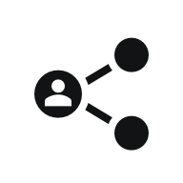


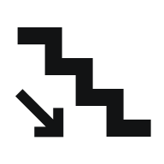

Recap: Risk Management
Risk management refers to the methods you can use to deal with the uncertainty of loss (risk). It is the process of handling pure risk by the way of reduction, elimination or transfer of risk. Methods to manage risk are :
Sharing Risk
Transfer Risk
Avoid Risk
Reduce Risk
Retain Risk
Distribution of risk among a particular number of individuals
Transfer the risk to another party, for example: Insurance
Involves not doing the activity that could carry the risk
Taking steps to prevent or reduce the loss
Accept the risk by assuming all financial responsibilities for that risk

Slide 7

Let us check your understanding
Please read the examples below and select the correct risk management method
01 Mary and Tim jointly buy a boat and pay $5000 each for the same. They decided to self-insure the boat and take responsibility in case any loss occurs.
Answer: Sharing risk
04 Post his retirement, Rob made all the investments with fixed rate investments for the fear of riskier investments where he could bear losses .
Answer: Avoid risk
05 Martin gave up his hobby of sky diving as he was worried that there was a risk of him dying from a sky diving accident.
Answer: Avoid risk
02 Rick has bought a homeowner’s policy to cover the risk of loss to his house.
Answer: Transfer risk
03 Jack does not go for scuba diving since he fears the risk of drowning.
Answer: Avoid risk
03 John installed a fire suppression system in his house to prevent the possibility or severity of a fire.
Answer: Reduce risk

Slide 8


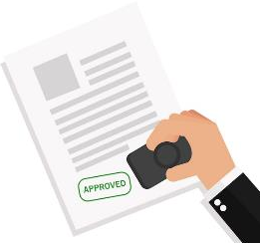


Recap: What is insurance?
Insurance is a protection against financial loss arising from an unexpected event.
Insurance companies/Insurers collect premiums to provide for this protection.
Claim is paid out to the insured for a covered loss from the premiums collected.
This helps in spreading the risk of a financial loss among a large number of people.

Slide 9
What is an insurance contract?
An insurance policy is a legally binding contract between two parties (Insurance company and the insured)
01
An insurance policy describes the rights and obligations of both parties
02
03
In an insurance contract, conditions for both the insurer and insured are spelled out in the policy document

Slide 10
Recap: Law of Large Numbers
Insurers handle risk in the form of pooling, following the Law of Large Numbers. ​
The Law of Large Numbers tells us that it is possible to accurately predict what will happen to a large group of similar risks. The larger the group becomes, the more accurate the predictions become. These statistics allow insurance companies to more accurately predict future losses.​
For example, with property and casualty insurance, the company has no idea which houses will burn this year, but rather approximately how many house fires will occur during the year. Companies must know this information before they can set insurance premiums.​

Slide 11







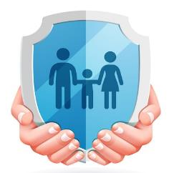




Fundamental Principles of Insurance
Utmost good faith
Both parties must disclose all facts
Both parties must have faith over each other
Subrogation
Enables insured to claim recovery amount from the responsible 3rd party
Allows insurer to pursue legal methods to recover loss amount
Indemnity
To set back insured to pre-loss financial state
Provides security/compensation against loss/damage for the exact loss amount
Contribution
Applicable when an insured has more than 1 policy for the same asset/entity
Insured can’t gain profit from it
Insurable Interest
Insured must have interest in the subject matter at the time of purchase of the policy
If there is no insured insurable interest, policy would be null & void
Proximate Cause
Means ‘nearest/direct cause’
Applicable when more than 2 causes of losses exist
The most effective cause of loss is considered
Loss Minimization
Insured must take reasonable steps to prevent or limit losses
If negligence worsens a loss, the insurer may reduce or deny the claim

Slide 12


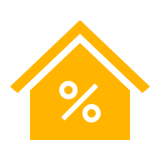
A deep dive into each principle
Utmost Good Faith
Both parties, insurer and insured should enter into contract in good faith.
Insured should provide all the facts and information correctly to the insurer .
Insurer should provide all the details regarding insurance contract.
Indemnity
The insurance company will restore the insured to the same financial position as was before the loss occurred—no profit, no loss.
Insured cannot make profit from an insurance contract.
The insured will not be compensated by the insurance company for an amount exceeding your economic loss.
Insurable Interest
Insured must have the insurable interest on the subject matter.
Any person, item, event, or action can have insurable interest if its loss or damage results in a financial burden/loss.

Slide 13



A deep dive into each principle
Subrogation
It is the right held by insurer to legally pursue a 3rd party that caused the loss to an insured.
It is done to recover the amount of the claim paid by the insurance carrier to the insured for the loss.
Contribution
Applicable if the insured has taken more than 1 policy for the same event.
If the loss arises and insured has taken more than one insurance policy, then the loss will be covered by the policies based on the proportion of the coverage the insurance policy provides. The insured cannot make a profit by claiming the loss of the same event from different policies or companies.
Proximate Cause
This principle is applicable when the loss is the result of two or more causes.
In case of a loss the most “dominant cause” of loss will be considered
Insurer pays the claim money only if the nearest cause is insured

Slide 14
A deep dive into each principle
Loss Minimization
The insured must make every effort to minimize losses to their insured property in the event of unforeseen incidents such as fire outbreak or explosion. They should take all necessary precautions and proactive measures to control and reduce the damage.
Insurance Coverage should never lead to negligence or irresponsible behavior. It remains the insured’s duty to safeguard their property and prevent further losses, ensuring responsible risk management.

Slide 15

Here are a few videos to help you understand the concepts better
https://www.youtube.com/watch?v=b8pt-jZce5M
https://www.youtube.com/watch?v=aYmr9zfynMM

Slide 16
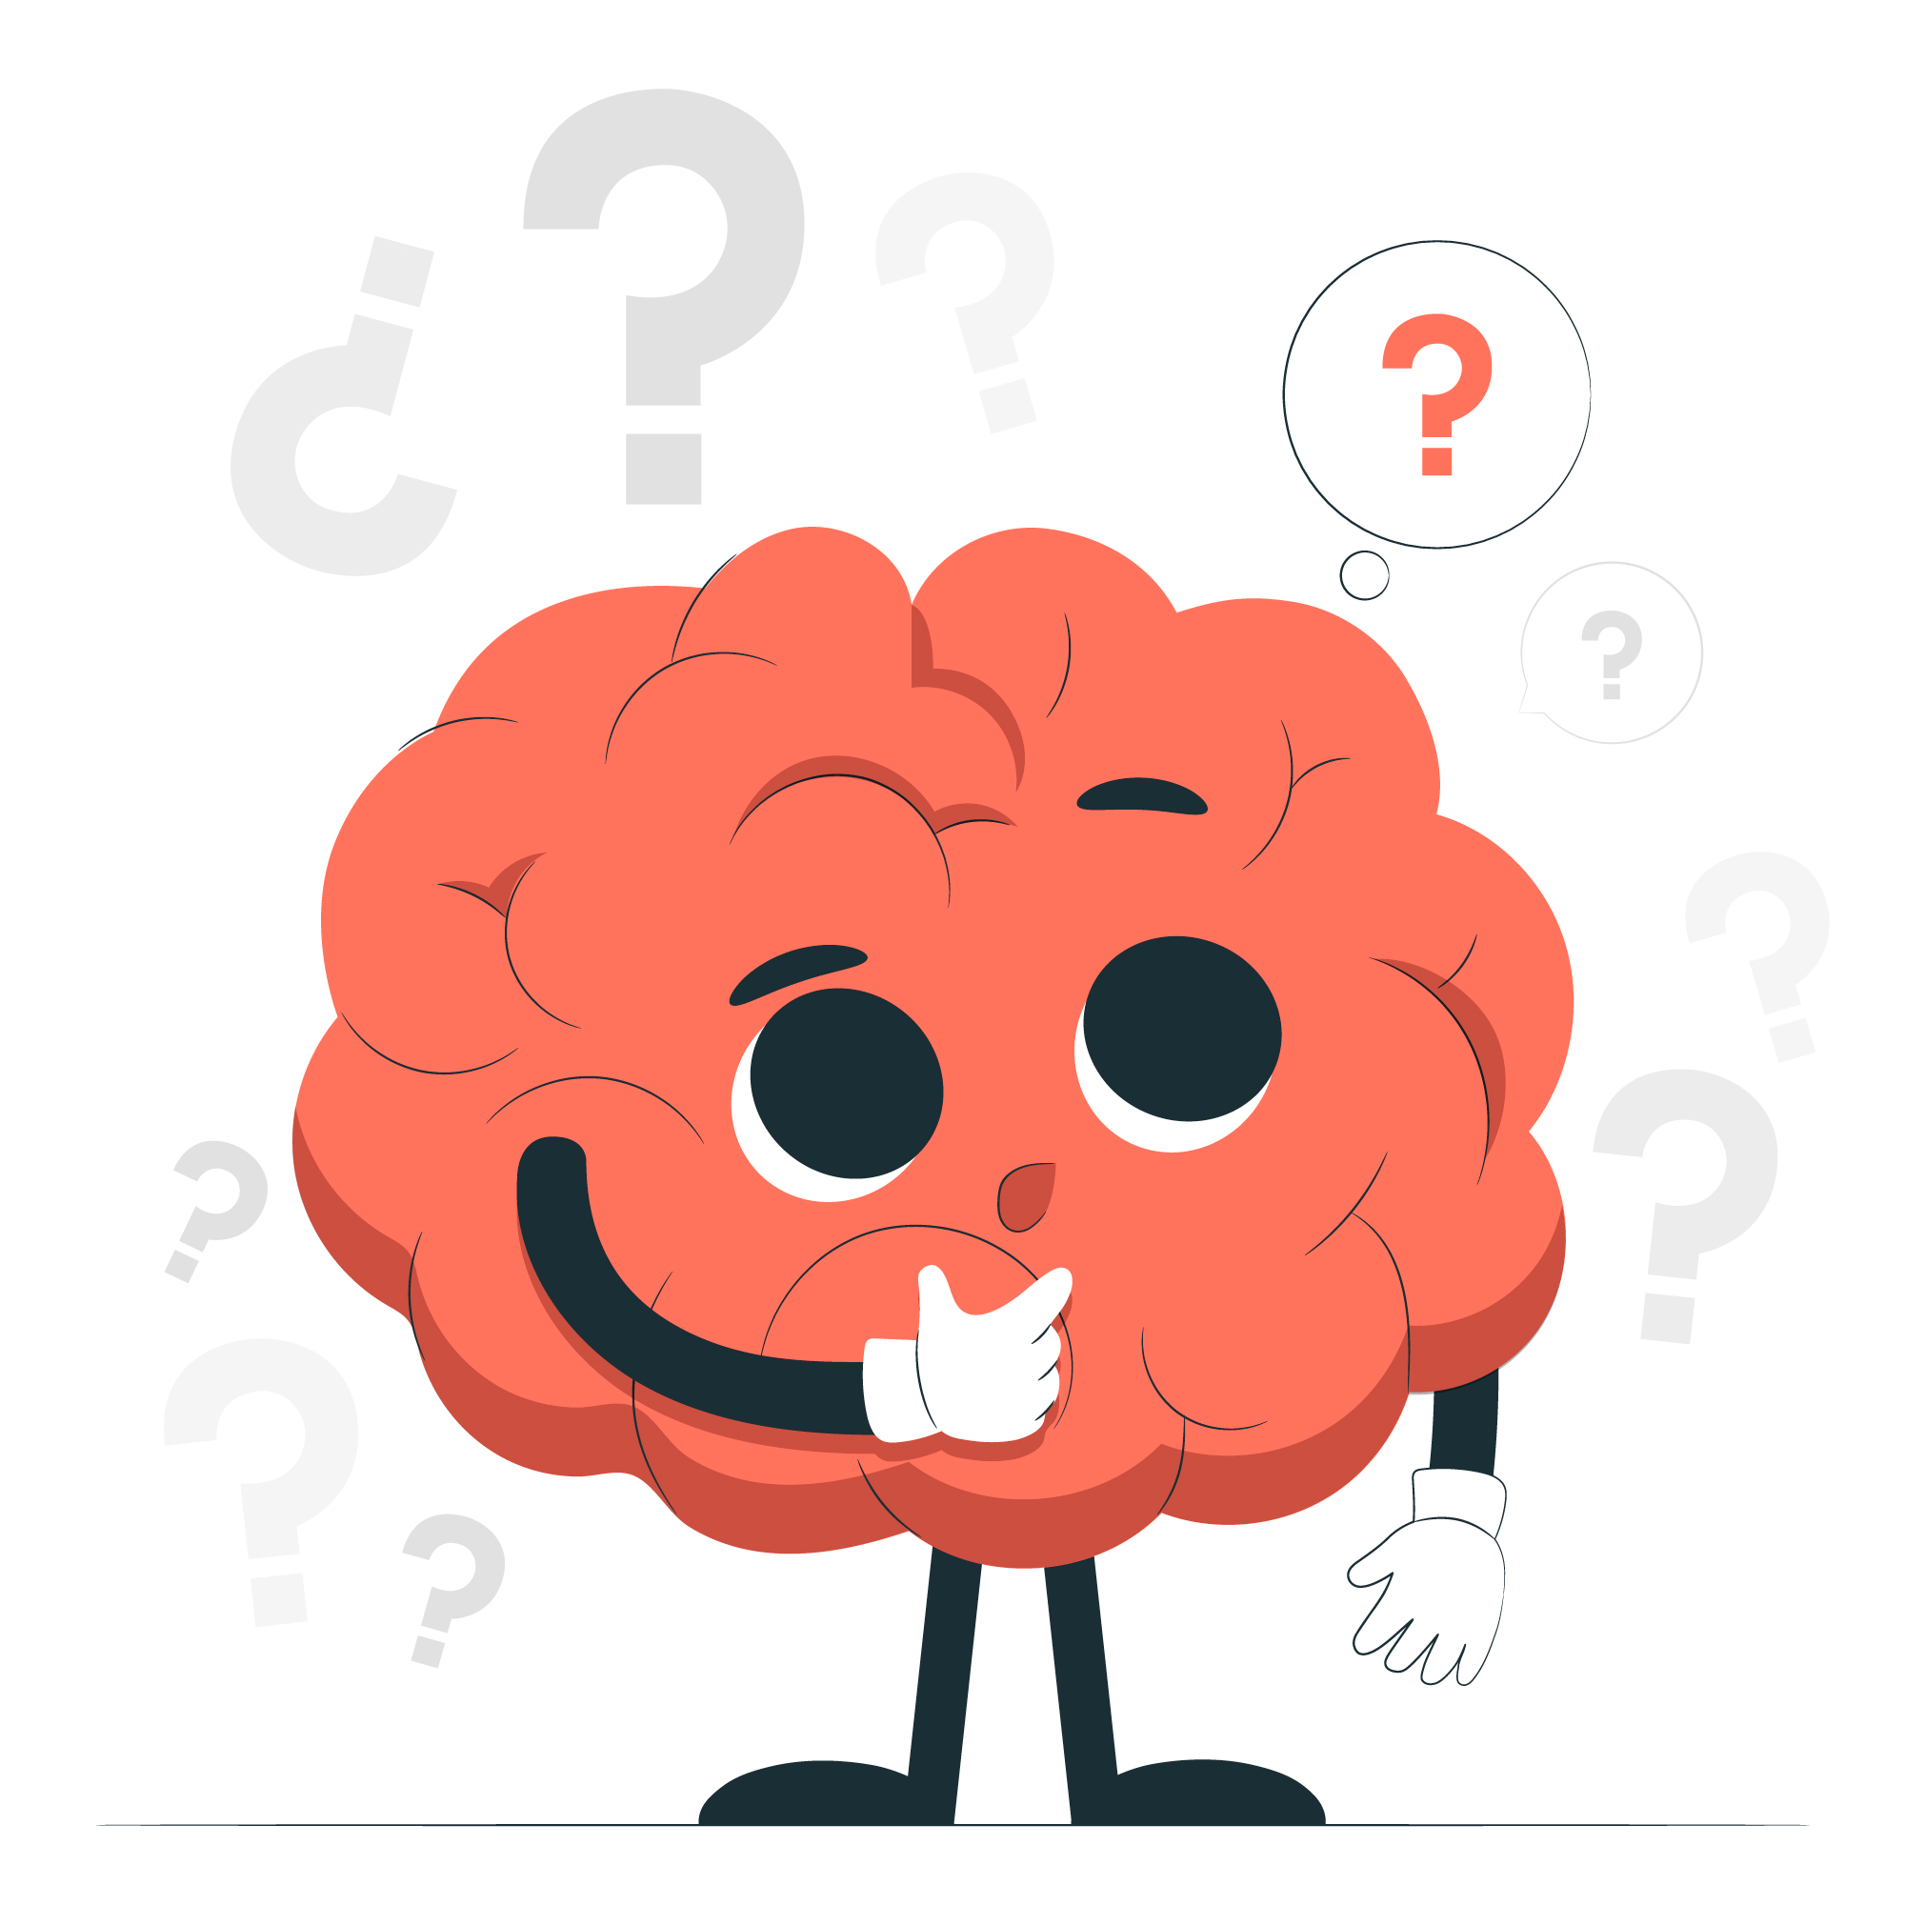
Let's check your understanding

Slide 17
Activity Instructions
1. Each team/group will be provided with a scenario-based case study.
2. Each team/group is required to answer the vase study within a time limit of 5 mins where they can internally discuss and then give their answer.
3. If the answer given is incorrect, there is no negative marking. The next question will be presented to the next team in line.
4. Upon giving the correct answer, every team will win a total of 20 points per answer.
5. After all case studies have been answered, the scorer will calculate the points and the winning team of the activity will be announced shortly.

Slide 18
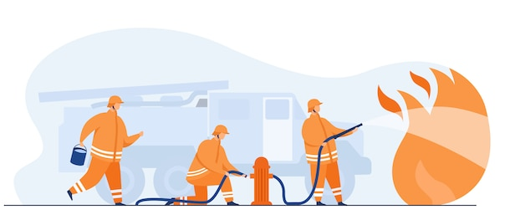
Knowledge Check
O1 John had a big house in San Francisco. He has backyard and a beautiful garden in front of the house. He had insured the house with ABC Insurance company for $200,000. Due to an electrical short circuit in the air conditioning unit, a fire broke out and the house got burnt and all the household furniture and equipment's got damaged. Since John had a coverage loss (fire) the insurance company will pay to rebuild his house to the same level it was prior to the loss.
Which principle of Insurance is being applied in this case ?
a. Utmost Good Faith
b. Contribution
c. Indemnity
Answer: Indemnity
Since insurance companies only insure pure risks and there is no opportunity for gain or profit with pure risks. In this case the insurance company will not build a larger, more elaborate house for him.
18

Slide 19
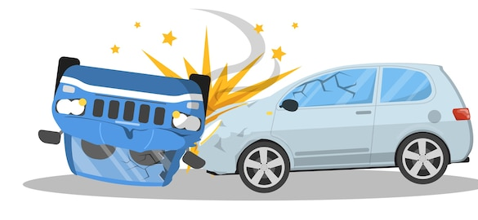
Knowledge Check
O2 David purchased an insurance policy for his car. His care met with an accident and got totally damaged. Insurer paid the full policy value to David as a claim. Can David sell the scrap and earn profits ?
Which principle of Insurance is being applied in this case ?
a. Utmost Good Faith
b. Subrogation
c. Indemnity
Answer: Subrogation
After paying the insurance claim, the insurer becomes the owner of subject matter. Now David can't sell the scrap that has remained after the car accident.

Slide 20
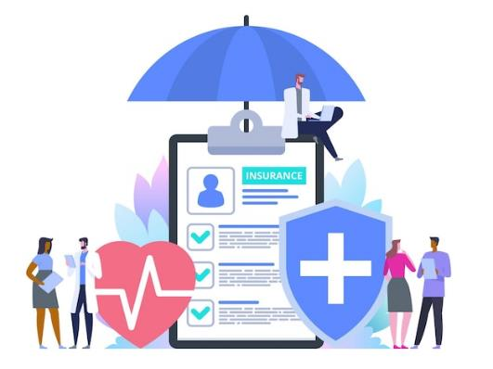
Knowledge Check
O3 Mary has taken Health Insurance from 2 health insurance providers, say A and B. Coverage amounts are as follows:
A. $ 2000 B. $ 2500
Mary got admitted to the hospital for illness and the total claim is $ 2000. Mary decides to use a policy from A insurance and got paid $ 2000.
She now goes to B and demands his claim again.
Is she eligible to get another claim? Which principle of Insurance is applicable?
Answer: Contribution
Mary cannot make profit by making a claim from B Insurance. She is not eligible since he has already received the claim
20
20

Slide 21
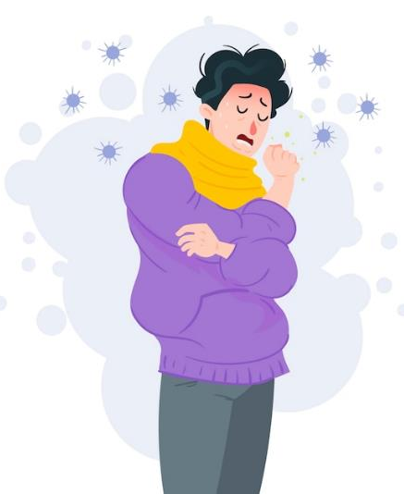
Knowledge Check
O4 Matt falls from a ladder at a low height and scratches his leg a little. He is taken to a hospital, and in the hospital, he contacts cholera from the next bed patient and dies.
What is the cause of death and Which principle of Insurance is applicable?
Answer: Proximate Cause
The cause of death is cholera and not the fall and the scratch on the leg. Thus, cholera will be taken as the Proximate cause.
21
21

Slide 22
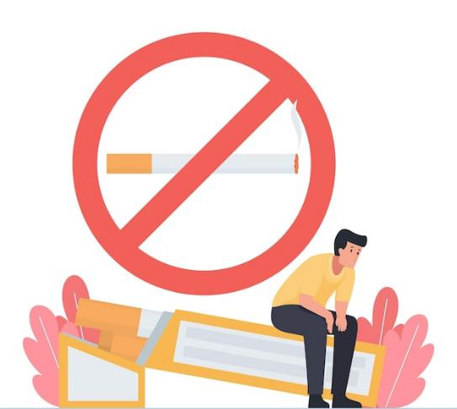
Knowledge Check
O5 John took a health insurance policy. At the time of taking policy, he was a smoker, and he didn't disclose this fact. He got cancer and filed a claim for the treatment expenses.
Which principle of Insurance is applicable?
Answer: Utmost Good Faith
Insurance company won't pay anything as John didn't reveal important factors that would have impacted the decision on the policy at the time of buying the health insurance policy.
22

Slide 23
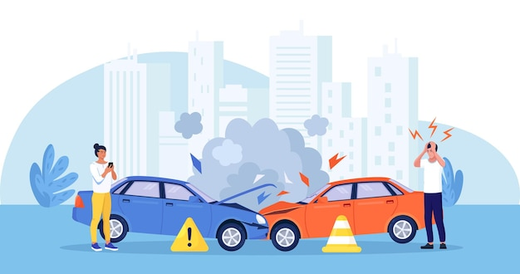
Knowledge Check
O3 If you get injured in a road accident, due to reckless driving of a third party, the insurance company will compensate your loss and will also sue the third party to recover the money paid as claim.
Which principle of Insurance is applicable ?
Answer: Subrogation
As it is the right held by insurer to legally pursue a 3rd party that caused the loss to an insured and recover the claim amount paid by the insurer.
23

Slide 24

Knowledge Check
O3 Basis your understanding of Principle of Insurable interest, read the below scenarios and mention if Insurable interest exists or not.
In case of life insurance spouse and dependents have insurable interest in the life of a person.
Corporations also have insurable interests in the life of its employees.
Marie will buy a Life Insurance policy to cover Tom Cruise’s life.
Joe will buy a homeowner’s policy for his neighbor's house.
John buys an insurance policy to get coverage for his football.
J wishes to take out a life insurance policy on his neighbor because his neighbor is a careless driver--who J thinks is likely to die in a car accident.
An American football team insures the best player of the team.
Corporation buys coverage to insure the chief executive officer (CEO).
24

Slide 25
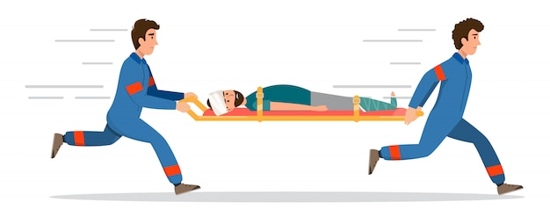
Knowledge Check
O8 Joe gets an insect bite while working in the farm and is going to the ER. On the way to the ER, the car meets a head-on collision with a semi truck, and all persons on board the ambulance die, including our man, Joe.
Which principle of Insurance is applicable?
Answer: Proximate Cause
The proximate cause of Joe’s death is the collision and not the insect bite. Collision being the cause of death is the dominant cause here whilst insect bite is inefficient and remote.
25

Slide 26
Thank you!

